Slide 1

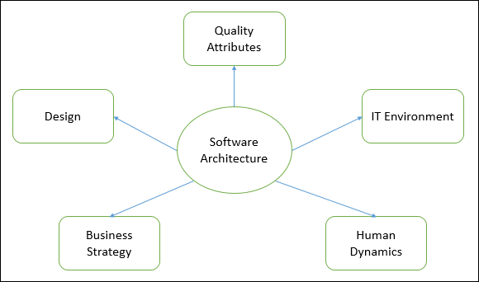
Software Architecture
July
2022

Slide 2
Plan
Overview
Definition
Characteristics of Software Architecture
SOLID principles of Software architecture
Software architecture pattern vs. design pattern
7 Best Software Architecture Patterns
Top software architecture visualization tools

Slide 3
Overview
Architecture is an important engineering step in the design and creation of software
The architecture describes the processes and structures of the entire project, determining the data throughput in different parts of the project, and allows you to optimize and scale the project in the future.

Slide 4
Overview
Definition
Software Architecture defines fundamental organization of a system and more simply defines a structured solution.
It defines how components of a software system are assembled, their relationship and communication between them. It serves as a blueprint for software application and development basis for developer team.

Slide 5
Overview
Characteristics of Software Architecture
Operational Architecture Characteristics
Structural Architecture Characteristics
Cross-Cutting Architecture Characteristics

Slide 6
Overview
Characteristics of Software Architecture
Operational Architecture Characteristics :
Availability
Performance
Reliability
Low fault tolerance
Scalability

Slide 7
Overview
Characteristics of Software Architecture
Structural Architecture Characteristics :
Configurability
Extensibility
Supportability
Portability
Maintainability

Slide 8
Overview
Characteristics of Software Architecture
Cross-Cutting Architecture Characteristics :
Accessibility
Security
Usability
Privacy
Feasibility

Slide 9
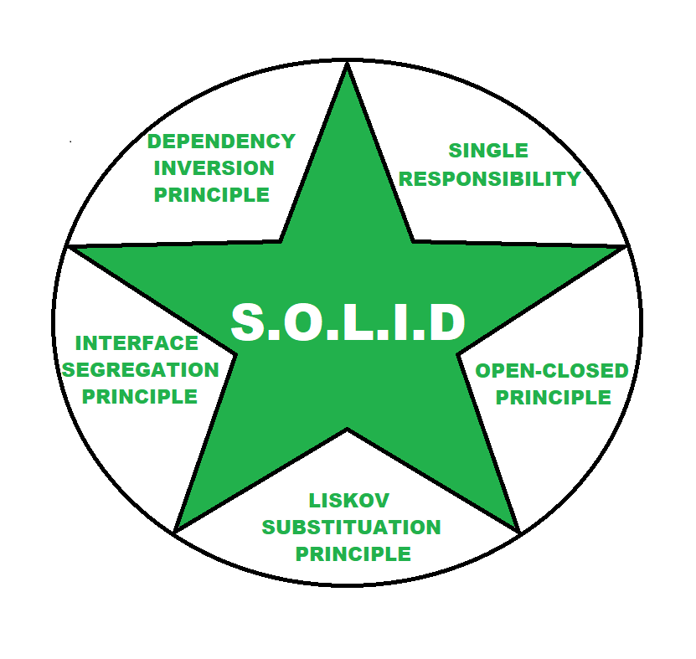
Overview
S.O.L.I.D principles of Software architecture
Each character of the word SOLID defines one principle of software architecture. This SOLID principle is followed to avoid product strategy mistakes. A software architecture must adhere to SOLID principle to avoid any architectural or developmental failure.

Slide 10
Overview
S.O.L.I.D principles of Software architecture
Single Responsibility
Each services should have a single objective.
Open-Closed Principle
Software modules should be independent and expandable.
Liskov Substitution Principle
Independent services should be able to communicate and substitute each other.

Slide 11
Overview
S.O.L.I.D principles of Software architecture
Interface Segregation Principle
Software should be divided into such microservices there should not be any redundancies.
Dependency Inversion Principle
Higher-levels modules should not be depending on low-lower-level modules and changes in higher level will not affect to lower level.

Slide 12
Software Architecture Pattern vs. Design Pattern
fundamental structural organization for software systems
Specification that could help in an implementation of a software
Conversion of software characteristics to a high-level structure
Description of all the units of the software system to support coding
Distributed functionality, system partitioning, protocol, interfaces,
security, reliability, scalability
Problem in software implementation

Slide 13
7 Best Software Architecture Patterns
1- Layered Architecture Pattern
2- Event-driven Architecture Pattern
3- Service-Oriented Architecture
4- Microservices Architecture Pattern
5- Client-Server Architecture Pattern
6- Master-Slave Architecture Pattern
7- Peer-to-Peer Architecture Pattern

Slide 14
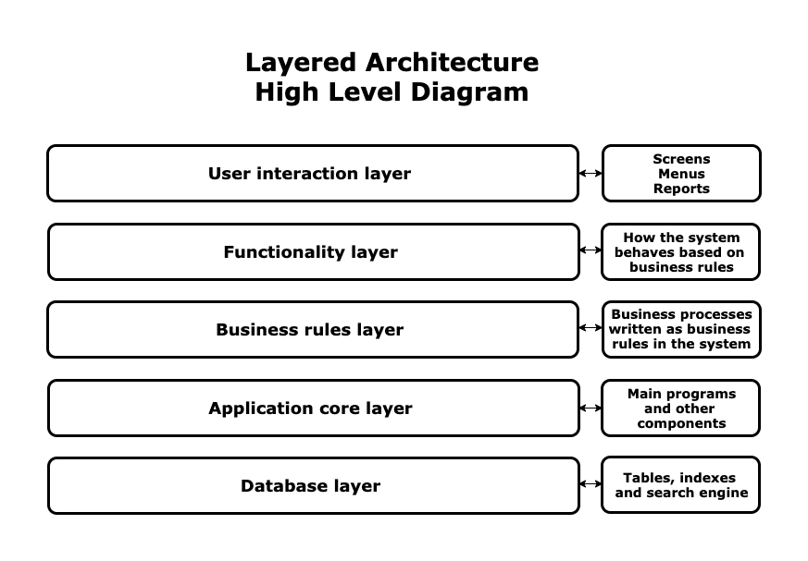
7 Best Software Architecture Patterns
1- Layered Architecture Pattern

Slide 15
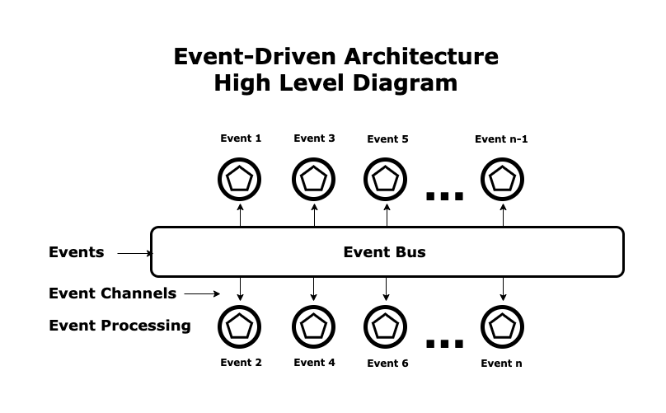
7 Best Software Architecture Patterns
2- Event-driven Architecture Pattern

Slide 16
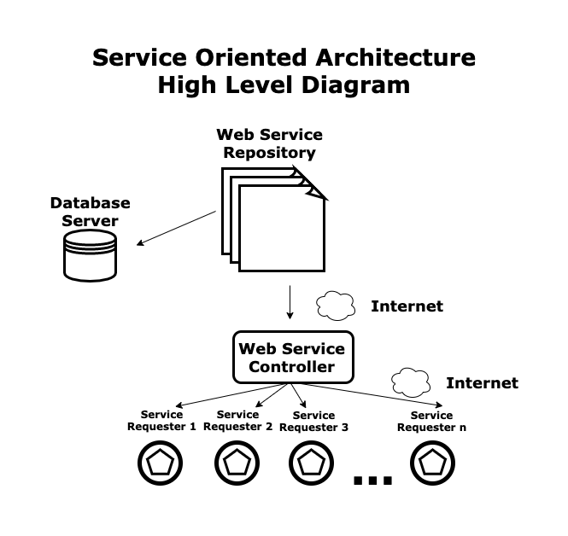
7 Best Software Architecture Patterns
3- Service-Oriented Architecture

Slide 17
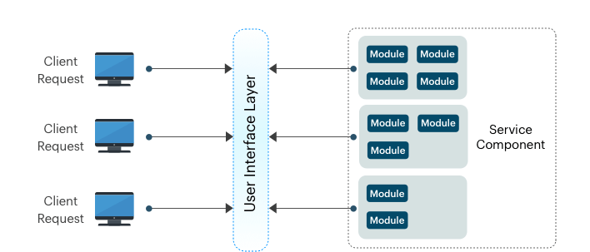
7 Best Software Architecture Patterns
4- Microservices Architecture Pattern

Slide 18

7 Best Software Architecture Patterns
5- Client-Server Architecture Pattern

Slide 19
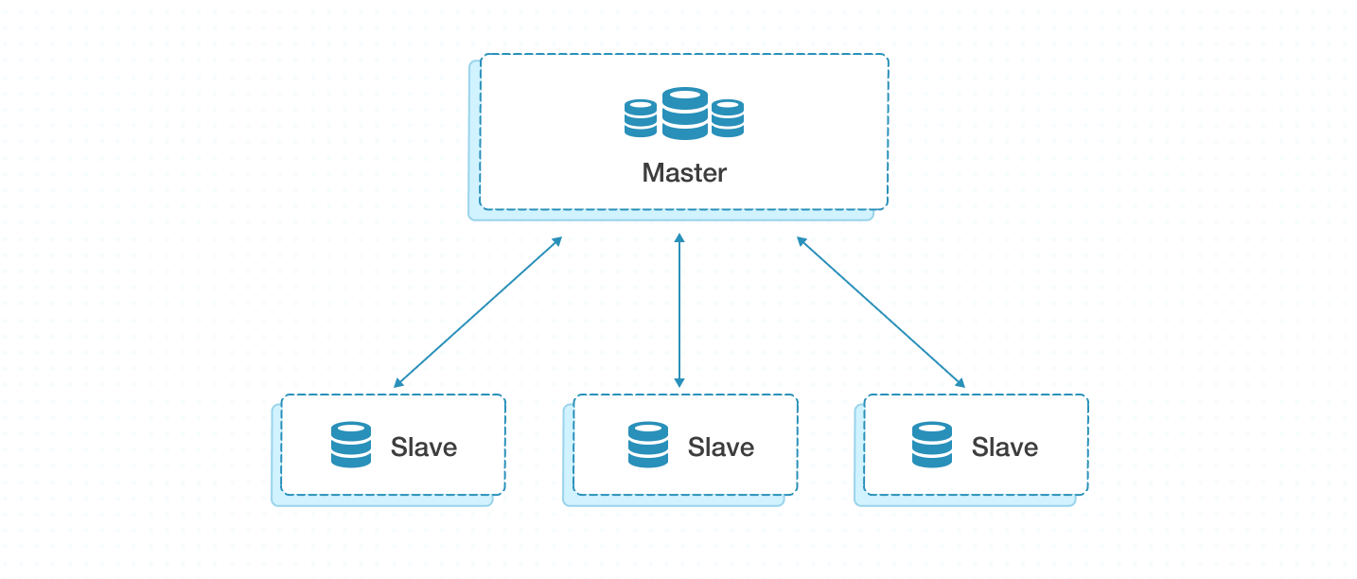
7 Best Software Architecture Patterns
6- Master-Slave Architecture Pattern

Slide 20
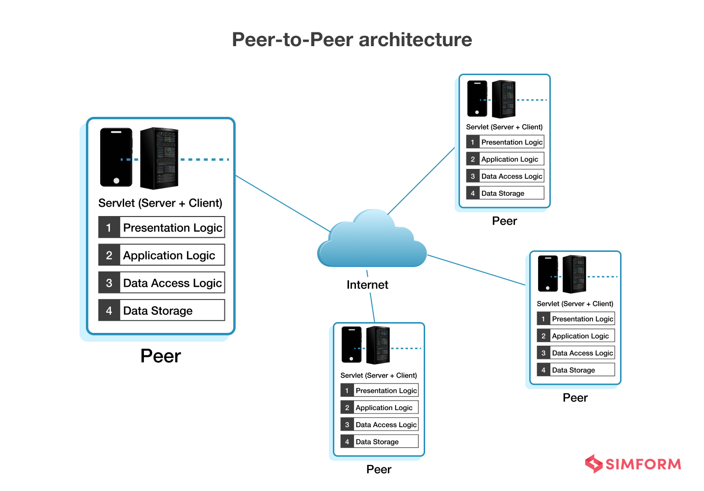
7 Best Software Architecture Patterns
7- Peer-to-Peer Architecture Pattern

Slide 21
Top software architecture visualization tools
1- Enterprise Architect
2- Microsoft Visio
3- Lucidchart
4- Visual Paradigm
5- Draw.io
6- Graphviz
7- Mermaid.js

Slide 22

THANK YOU!
Amos Sejour
Email
amos.sejour@genspark.net

